Slide 1





THEORY
Training Program 01
Advanced NLP & Large Language Models (LLMs)

Slide 2
THEORY
Training Program 01
M01: Text Preprocessing
M02: Word and Sentence Embeddings
M03: Transformer Architectures
M04: Entity-Centric NLP
M05: Applied NLP Tasks
M06: Multimodal NLP
M07: LLM Fundamentals
M08: Prompt Engineering
M09: Fine-Tuning & PEFT
M10: RAG & Real-World Projects

Slide 3
MODULE M01
TEXT PREPROCESSING
CHAPTER M06
Multimodal NLP

Slide 4
THEORY
Training Program 01
6.1 Introduction to Multimodal and Cross-Modal NLP
6.2 CLIP: Bridging Vision and Language
6.3 Whisper: Unified Speech Processing (ASR)
6.4 Knowledge-Augmented Text Enrichment
6.5 Summary and the Future of Unified AI

Slide 5
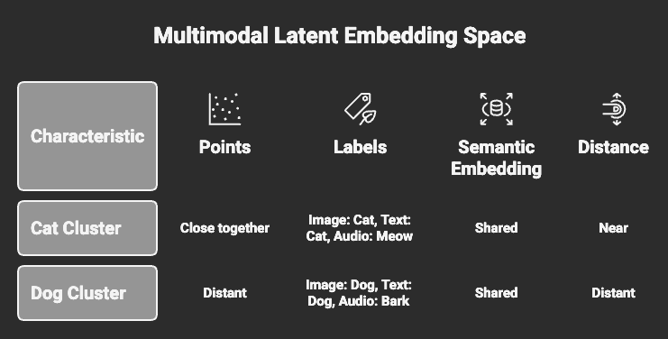
M01.1 BPE
M06
Chapter 6.1 Introduction to Multimodal and Cross-Modal NLP
Multimodal vs Cross-Modal AI
Multimodal AI: simultaneous processing of multiple modalities.
Cross-modal AI: translation between modalities (text ↔ image ↔ audio).
Core challenge: semantic alignment across heterogeneous data.
Unified latent space enables modality-agnostic reasoning.

Slide 6
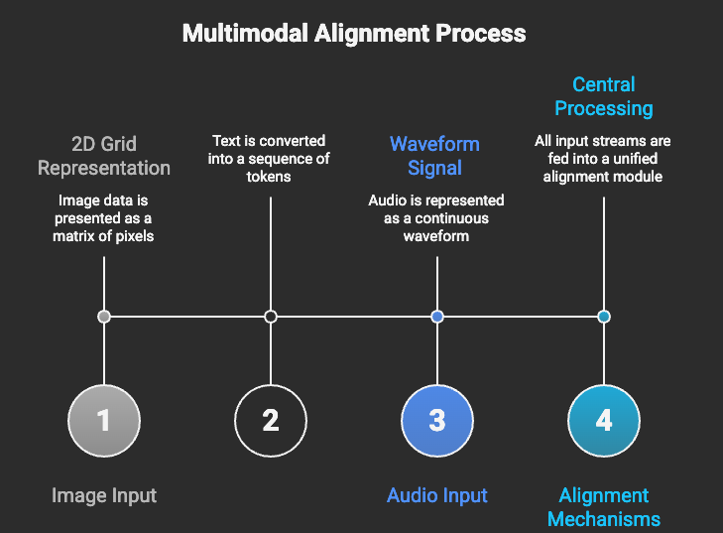
M01.1 BPE
M06
Chapter 6.1 Introduction to Multimodal and Cross-Modal NLP
The Alignment Problem
& Unified Representations
Modalities differ in structure, scale, and noise characteristics.
Alignment achieved via contrastive learning and cross-attention.
Semantic similarity replaces symbolic matching.
Foundation of generalizable multimodal intelligence.

Slide 7
THEORY
Training Program 01
6.1 Introduction to Multimodal and Cross-Modal NLP
6.2 CLIP: Bridging Vision and Language
6.3 Whisper: Unified Speech Processing (ASR)
6.4 Knowledge-Augmented Text Enrichment
6.5 Summary and the Future of Unified AI

Slide 8
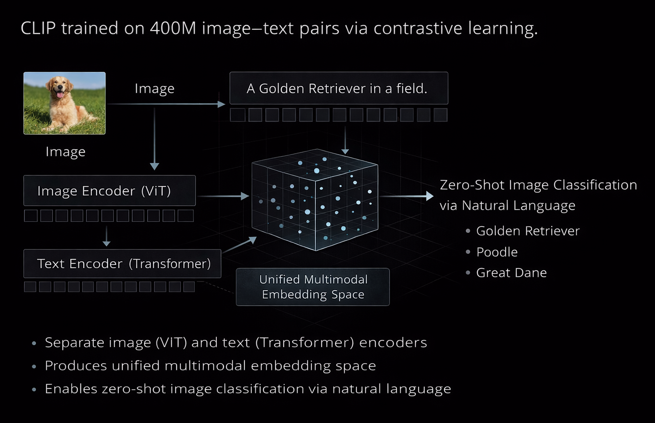
M01.1 BPE
M06
Chapter 6.2 CLIP: Bridging Vision and Language
Vision–Language Bridging
CLIP trained on 400M image–text pairs via contrastive learning.
Separate image (ViT) and text (Transformer) encoders.
Produces unified multimodal embedding space.
Enables zero-shot image classification via natural language.

Slide 9
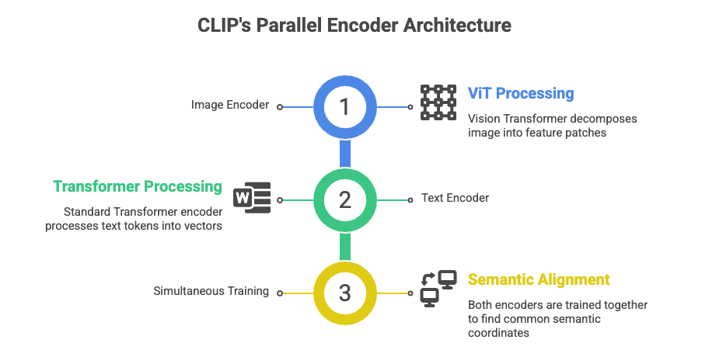
M01.1 BPE
M06
Chapter 6.2 CLIP: Bridging Vision and Language
Separate Text and Image Encoders

Slide 10
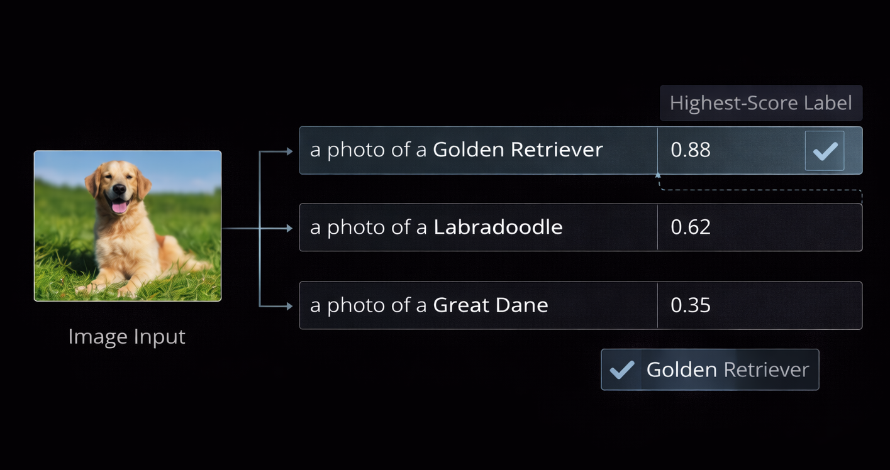
M01.1 BPE
M06
Chapter 6.2 CLIP: Bridging Vision and Language
CLIP in Practice: Zero-Shot
& Generative Guidance
Zero-shot image classification without task-specific training
Natural language prompts act as dynamic labels
Backbone for image retrieval at scale
Semantic guidance engine for text-to-image generation

Slide 11
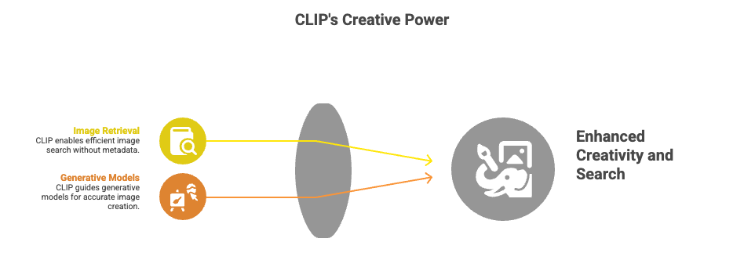
M01.1 BPE
M06
Chapter 6.2 CLIP: Bridging Vision and Language
Applications: Image Retrieval and Captioning

Slide 12
THEORY
Training Program 01
6.1 Introduction to Multimodal and Cross-Modal NLP
6.2 CLIP: Bridging Vision and Language
6.3 Whisper: Unified Speech Processing (ASR)
6.4 Knowledge-Augmented Text Enrichment
6.5 Summary and the Future of Unified AI

Slide 13
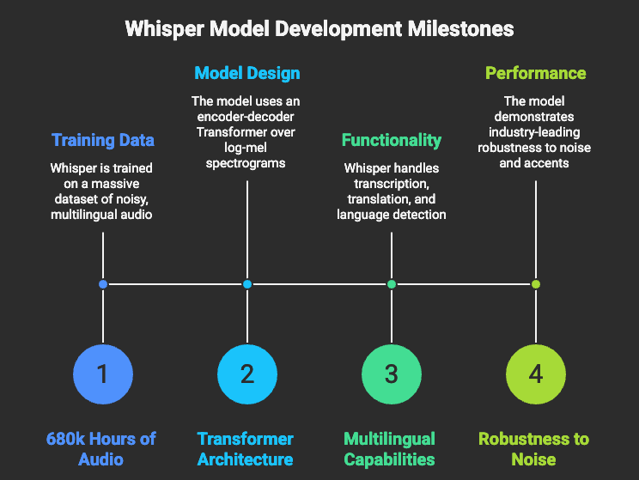
M01.1 BPE
M06
Chapter 6.3 Whisper: Unified Speech Processing (ASR)
Whisper: Robust Speech-to-Text
Whisper trained on 680k hours of noisy, multilingual audio.
Encoder-decoder Transformer over log-mel spectrograms.
Handles transcription, translation, and language detection.
Industry-leading robustness to noise and accents.

Slide 14
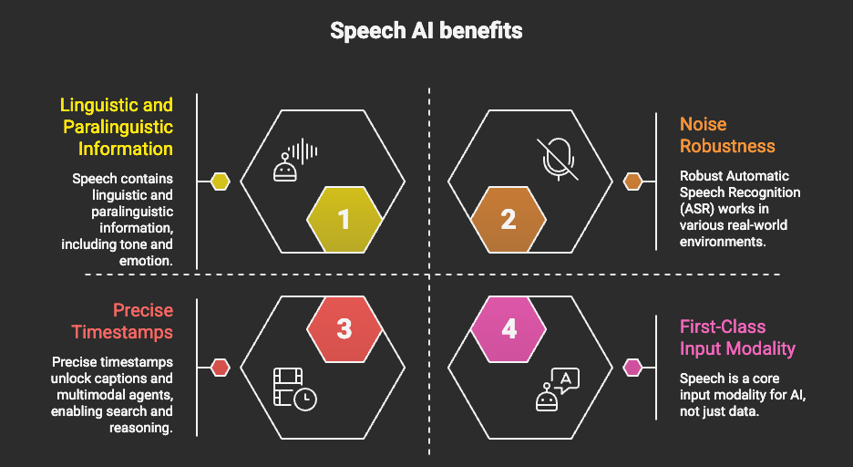
M01.1 BPE
M06
Chapter 6.3 Whisper: Unified Speech Processing (ASR)
Speech as a Multimodal Signal
Speech contains linguistic + paralinguistic information
Noise robustness enables real-world deployment
Precise timestamps unlock captions and multimodal agents
Speech becomes first-class AI input modality

Slide 15
THEORY
Training Program 01
6.1 Introduction to Multimodal and Cross-Modal NLP
6.2 CLIP: Bridging Vision and Language
6.3 Whisper: Unified Speech Processing (ASR)
6.4 Knowledge-Augmented Text Enrichment
6.5 Summary and the Future of Unified AI

Slide 16
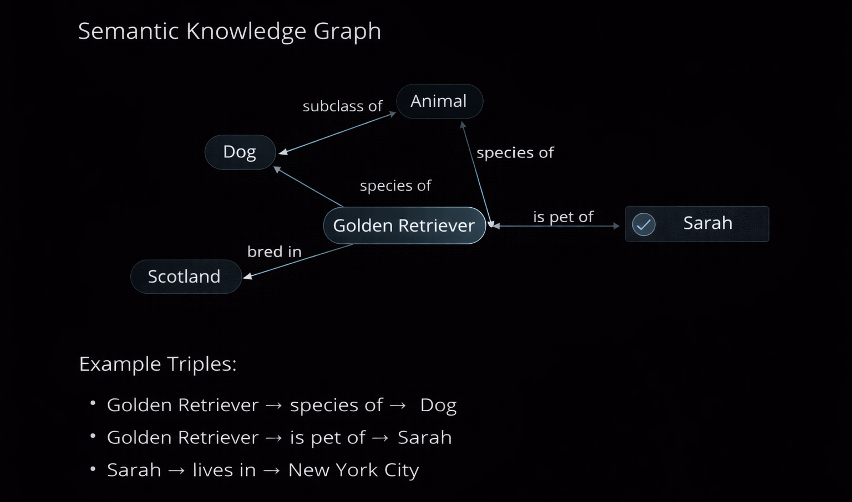
M01.1 BPE
M06
Chapter 6.4 Knowledge-Augmented Text Enrichment
Knowledge Graphs as the
Anchor of Truth
Knowledge Graphs represent facts as entities and relations
Triples (subject–predicate–object) form deterministic truth layer
Neural models lack factual persistence without KGs
KGs enable explainability and verification

Slide 17
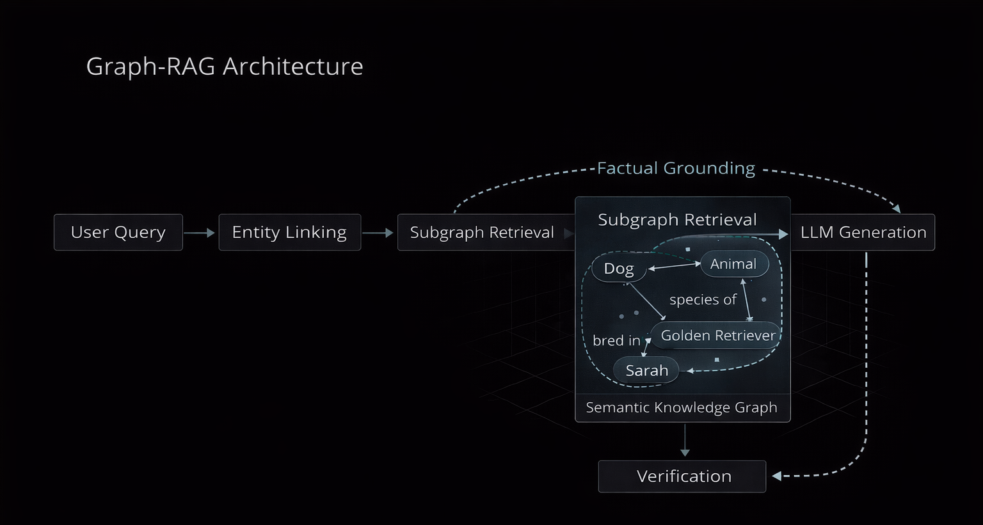
M01.1 BPE
M06
Chapter 6.4 Knowledge-Augmented Text Enrichment
Knowledge-Augmented
Generation & Graph-RA
KG embeddings bridge symbolic graphs and neural vectors
Graph retrieval replaces raw text retrieval
Sub-graph grounding reduces hallucinations
Gold standard for regulated domains (law, medicine)

Slide 18
THEORY
Training Program 01
6.1 Introduction to Multimodal and Cross-Modal NLP
6.2 CLIP: Bridging Vision and Language
6.3 Whisper: Unified Speech Processing (ASR)
6.4 Knowledge-Augmented Text Enrichment
6.5 Summary and the Future of Unified AI

Slide 19
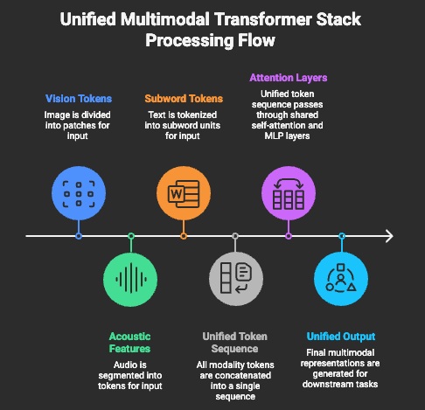
M01.1 BPE
M06
Chapter 6.5 Summary and the Future of Unified AI
From Modular Pipelines to Unified Models
Speech contains linguistic + paralinguistic information
Noise robustness enables real-world deployment
Precise timestamps unlock captions and multimodal agents
Speech becomes first-class AI input modality

Slide 20
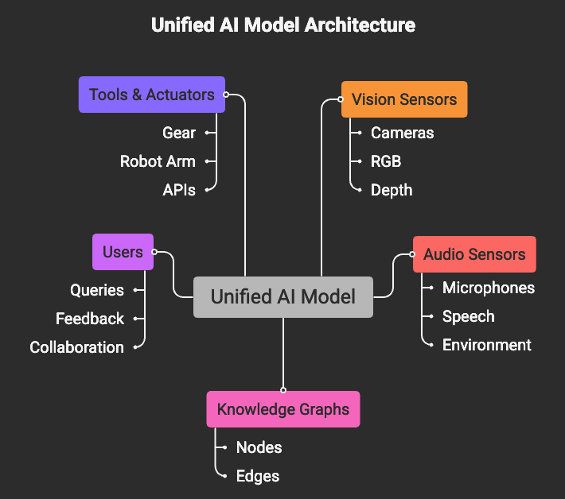
M01.1 BPE
M06
Chapter 6.5 Summary and the Future of Unified AI
Risks, Ethics & Bias in Multimodal AI
Speech contains linguistic + paralinguistic information
Noise robustness enables real-world deployment
Precise timestamps unlock captions and multimodal agents
Speech becomes first-class AI input modality

Slide 21
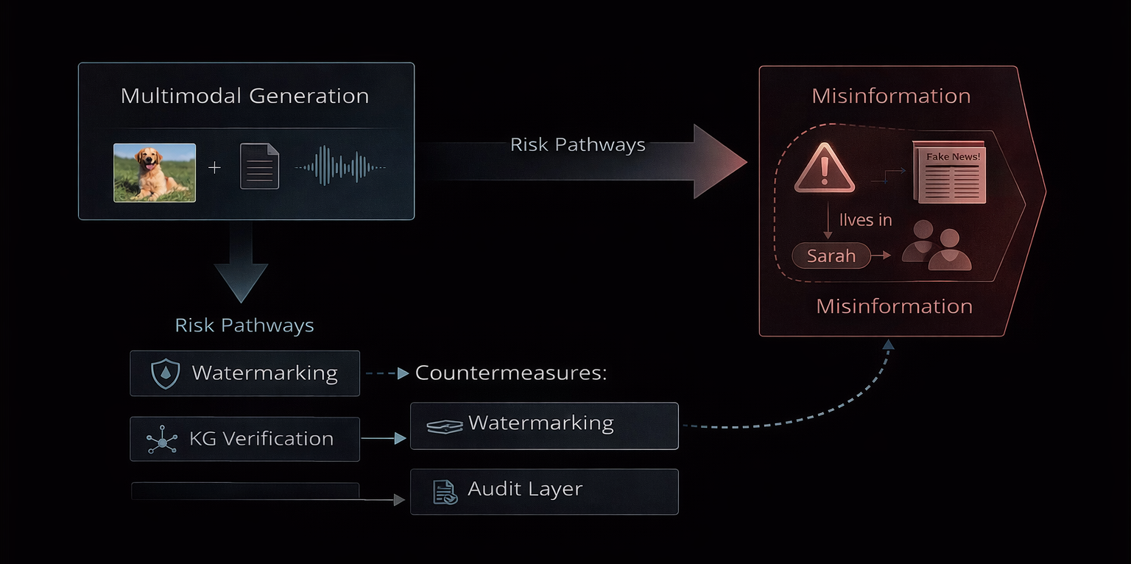
M01.1 BPE
M06
Chapter 6.5 Summary and the Future of Unified AI
The Future: Unified AI Systems
Language as cognitive core, multimodality as sensory system.
Alignment across modalities enables real-world intelligence.
Knowledge grounding ensures reliability.
Foundation for agentic, autonomous systems.

Slide 22
M06
Academic & Technical References
Dosovitskiy et al. (2020) — An Image is Worth 16×16 Words: Transformers for Image Recognition at Scale
Girdhar et al. (2023) — ImageBind: One Embedding Space To Bind Them All
Radford et al. (2021) — Learning Transferable Visual Models From Natural Language Supervision (CLIP)
Jia et al. (2021) — Scaling Up Vision-Language Representation Learning with Noisy Text Supervision (ALIGN)
Zhai et al. (2022) — LiT: Zero-Shot Transfer with Locked-image Tuning
Radford et al. (2022) — Robust Speech Recognition via Large-Scale Weak Supervision (Whisper)
Chan et al. (2015) — Listen, Attend and Spell

Slide 23
M06
Academic & Technical References
Bordes et al. (2013) — Translating Embeddings for Modeling Multi-relational Data (TransE)
Liu et al. (2020) — K-BERT: Enabling Language Representation with Knowledge Graph
Radford et al. (2024) — Multimodal Transformers as Universal Reasoners
OpenAI Research — GPT-4o Multimodal Architecture
Meta AI Research — ImageBind & Unified Multimodal Intelligence
Google Research — Gemini Multimodal Systems
NVIDIA Research — Hardware Acceleration for Multimodal Transformers

